Slide 1
Credit card fraud detection using machine learning
Saurabh Biswas
Dsc550 T302
Bellevue University

Slide 2
Contents
Introduction
Proposal
Why Data Science
High Level Process Overview
Data
Data Cleaning & Exploratory Data Analysis
Model
Comparison
Conclusion & Future Work

Slide 3
Introduction
Unauthorized Use of Credit Card - Fraudulent Transaction.
$24.26 Billion Loss on 2018 due to Payment Fraud.
USA Faces Highest Fraud Loss - 38.6%.
Manual System for Fraud detection - Human Dependent, Hard to Maintain.

Slide 4
Proposal
Machine Learning Technique to Combat Fraud.
ANN, Random Forest, Logistic Regression.
Training and Cross Validation.
Compare performance.
Select & Test the Best Model.

Slide 5
Why Data science ?
Manual Fraud Detection System – Human Dependent.
Rely on Domain Expertise.
High Man Hours to Keep the System Running.
Less Human Involvement – Machine Learning.
Once Trained - Minimal Maintenance Required.
Adaptable to Future Change.

Slide 6
Process overview
Gather Sample Data from Kaggle.
Perform Basic Analysis on the Data.
Split into Train & Test.
Carry Out Exploratory Data Analysis
Data Cleaning
Set up Pipeline for Model

Slide 7
Process overview
Parameter Tuning and Train Models.
Compare Cross Validation Matric.
Test the Best Model.
Set up Pipeline for Best Model
Train on Entire Dataset.

Slide 8
Data
Source: Kaggle
Overview:
30 Independent Variables
28 Variables PCA Transformed.
One Output Class.
284807 Observations.
Highly Imbalanced Output Class – 0.17% Minority (Fraud).
Train Test Split (75%/25%).
Use of Seed for Reproducibility.

Slide 9
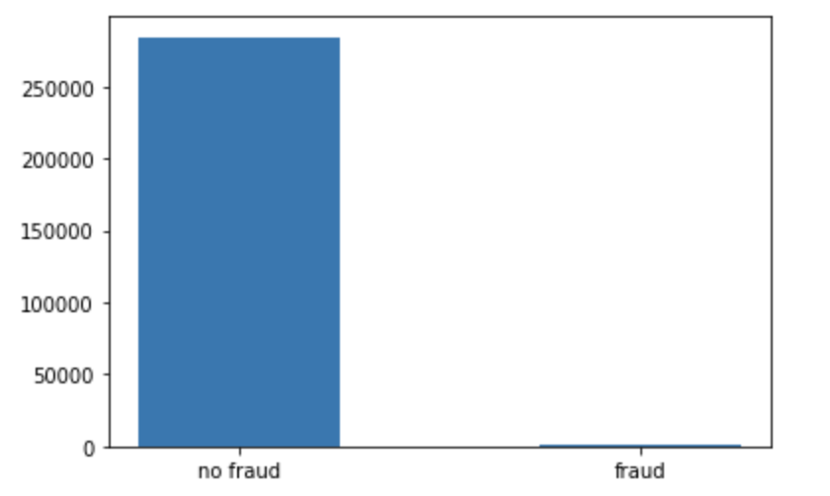
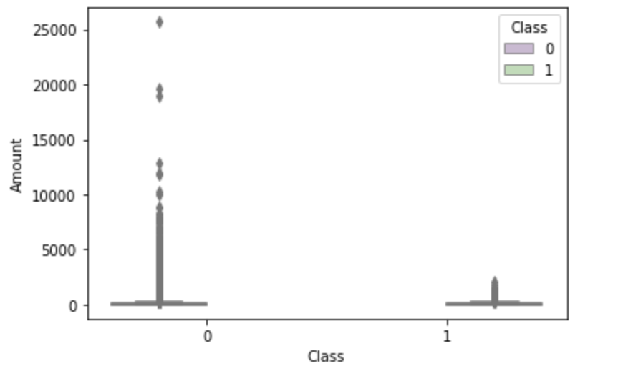
Data

Slide 10
Data Cleaning & Exploratory Data Analysis
No Null Value.
V1 through V28 PCA Transformed.
Scaling Required for Time and Amount.
Negative Correlation With Output: V17, V14, V12, V10.
Positive Correlation With Output: V11, V4, V2, V21
V14, V12, V10, V2 & V21 – Outliers Removal.
Convert Class Variable to Binary.

Slide 11
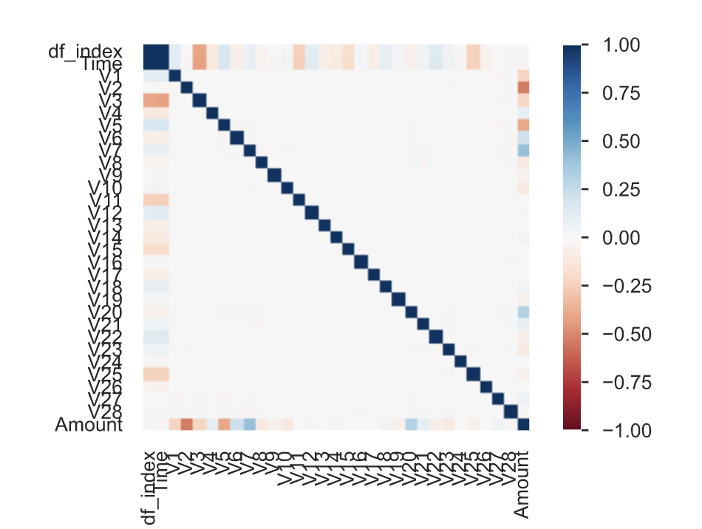
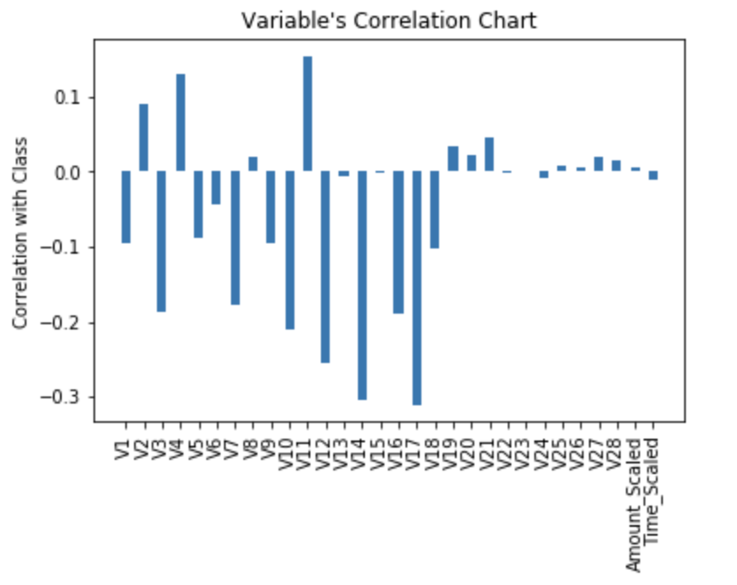
Correlation Heat Map

Slide 12
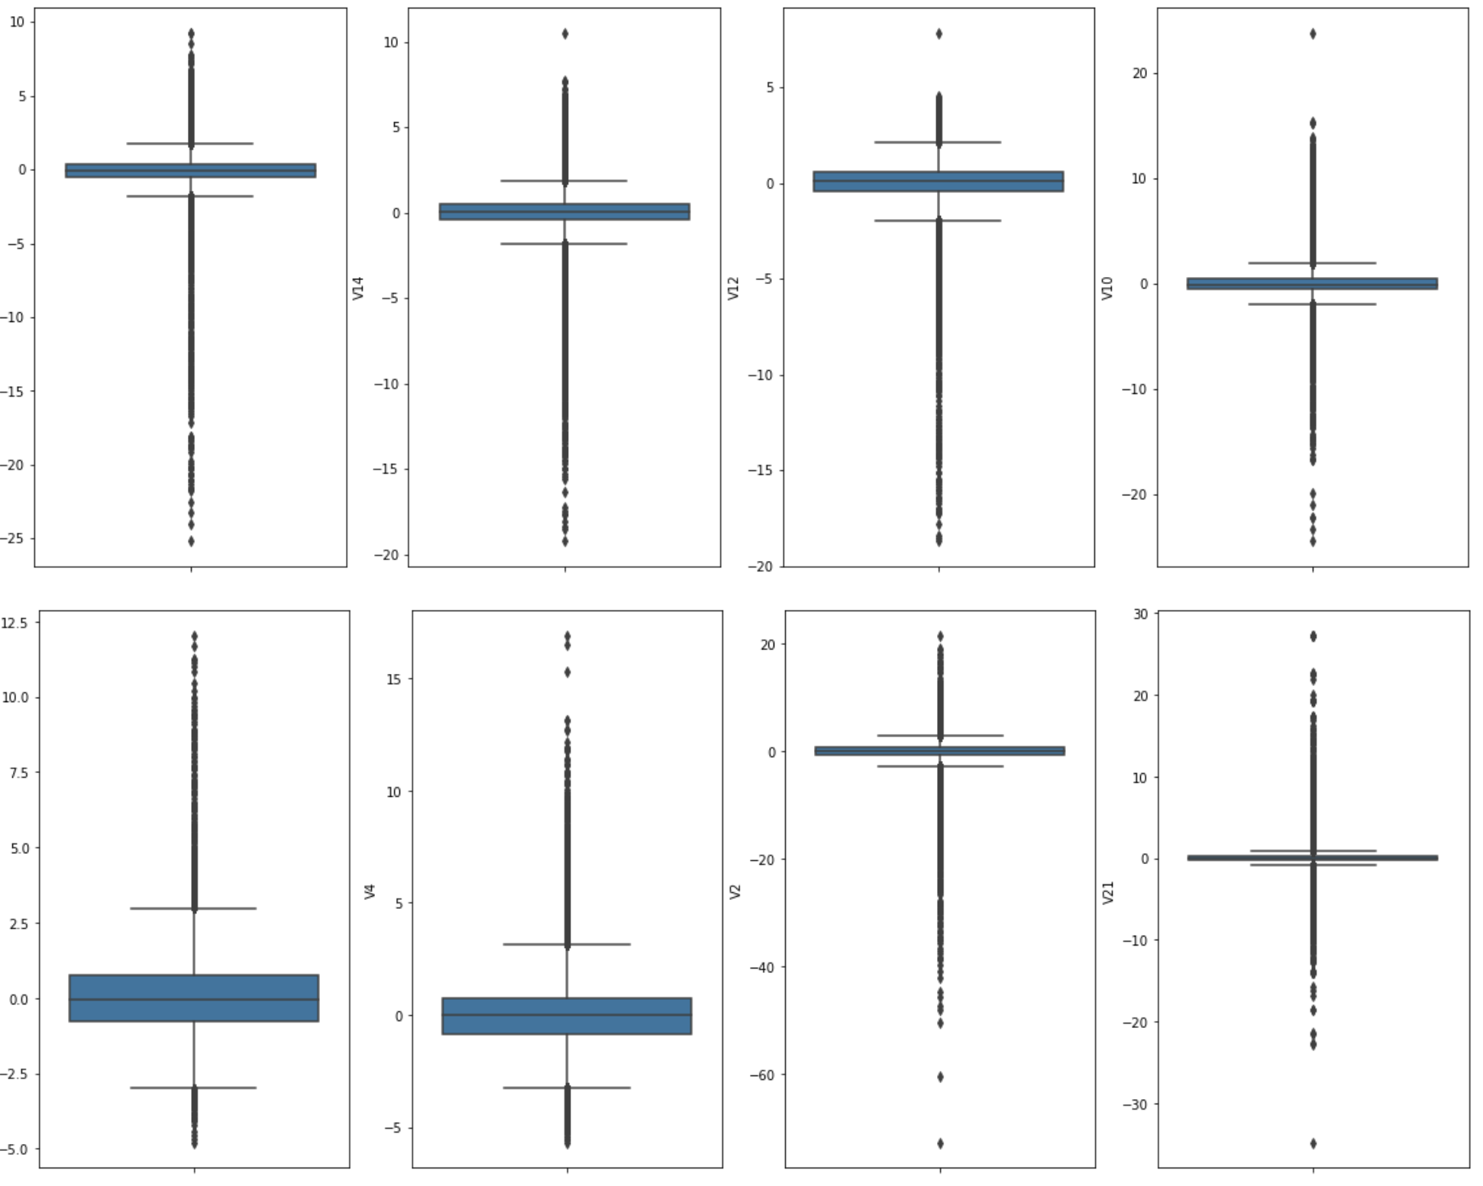
Outliers

Slide 13
Pipeline setup – model
ColumnTransformer for Scaling in Pipeline - Amount and Time.
RF Pipeline with Seed.
RF Parameter – Weight, Estimator, Features, Max_Depth.
Logistic Regression Pipeline – SelectKBest, Weight, Seed.
Logistic Regression Parameter – C, select best k.
ANN Pipeline – Seed.
ANN Parameter – Solver, Maxiter, Learning Rate.

Slide 14
Model Cross Validation
Models a Tuned, Trained & Cross-Validated using GridSearchCV.
RF is not Calibrated.
Future Plan is to Calibrate RF.
Selected ANN based on Best Score.

Slide 15
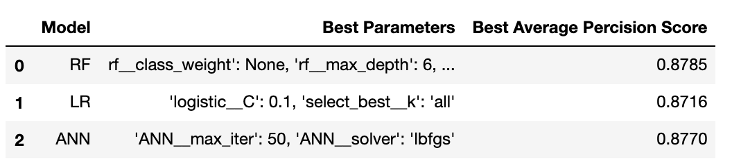
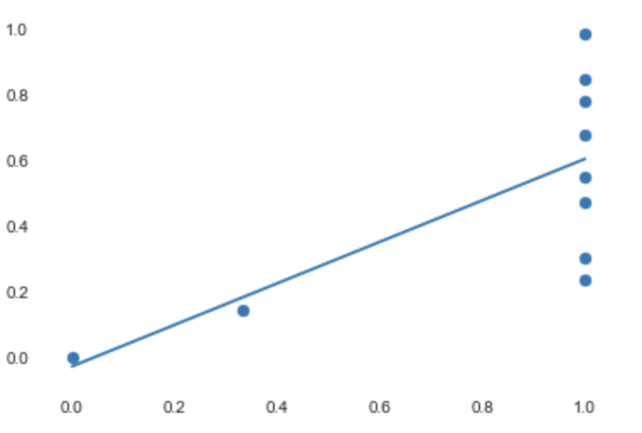
Model Cross Validation

Slide 16
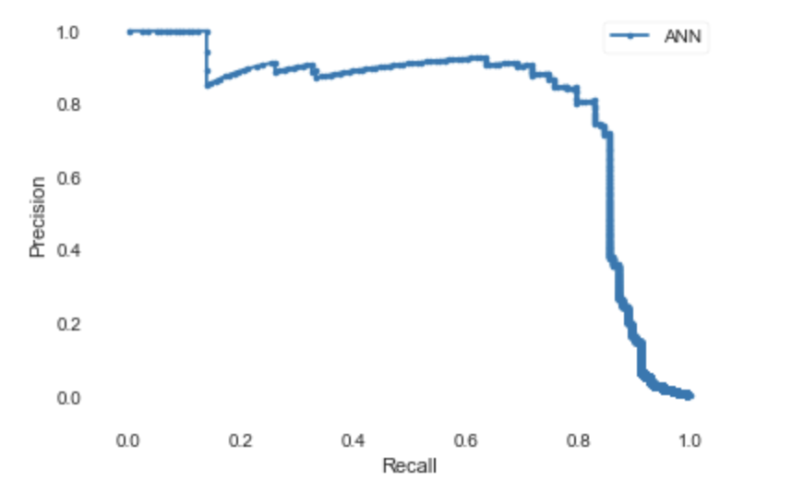

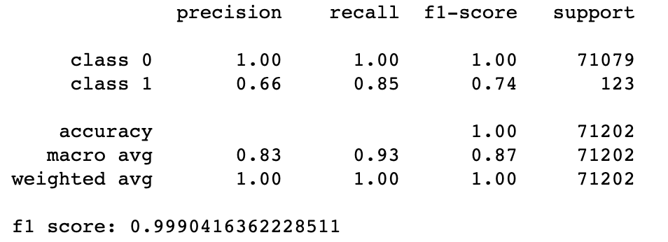
Model Test

Slide 17
Conclusion
All the Models performed Pretty Well.
Average Precision Scores are Similar.
Random Forest can be Improved with Calibration.
Selected ANN based on the Cross Validation Score.
Trained ANN on Entire Dataset using best Parameter Pipelie.

